Slide 1
UNDERSTANDING GWAS : A tutorial with step by step guidelines to perform GWAS
Dr. K. Sangeetha
Email: k26sangeetha@gmail.com
LinkedIn:linkedin.com/in/dr-sangeetha-kannan-08217883

Slide 2
This tutorial follows steps given in below reference with more elaborate explanation of the steps and commands used to carry out this study
https://www.ncbi.nlm.nih.gov/pmc/articles/PMC6001694/
Marees AT, de Kluiver H, Stringer S, Vorspan F, Curis E, Marie-Claire C, Derks EM. A tutorial on conducting genome-wide association studies: Quality control and statistical analysis. Int J Methods Psychiatr Res. 2018 Jun;27(2):e1608. doi: 10.1002/mpr.1608. Epub 2018 Feb 27. PMID: 29484742; PMCID: PMC6001694

Slide 3
Introduction
Genome‐wide association studies (GWAS) is a popular method of research to identify genetic variants called single nucleotide polymorphisms (SNPs) associated with certain phenotypic traits such as a disease by scanning the entire genome of large number of individuals
The tutorial clearly explains key concepts and steps to conduct GWAS on genomic data (to identify SNPs associated with neurological disease) using example scripts based on PLINK, PRSice and R (https://github.com/MareesAT/GWA_tutorial/) and structured to run on UNIX/LINUX computer or server at the shell prompt

Slide 4
Tutorial covering GWAS steps in brief
Applying quality control (QC) procedures on the given genotype data earlier to conducting GWAS
Steps to perform tests of association between SNPs and phenotypic traits of interest alongside controlling for potential confounders
Steps to conduct PRS analysis

Slide 5
Installation of requisite software
PLINK and R

Slide 6
Installation of PLINK in Linux
A Linux workstation running Ubuntu 20.3x x64 was used for running PLINK binary and R commands
Open terminal and follow the steps below:
wget https://zzz.bwh.harvard.edu/plink/dist/plink-1.07-x86_64.zip
unzip plink-1.07-x86_64.zip
cd plink-1.07-x86_64
sudo cp plink /sbin/

Slide 7
Installation of R in Linux
I installed R in Linux using below steps in the terminal
sudo apt update –qq
sudo apt install --no-install-recommends software-properties-common dirmngr
wget -qO- https://cloud.r-project.org/bin/linux/ubuntu/marutter_pubkey.asc | sudo tee -a /etc/apt/trusted.gpg.d/cran_ubuntu_key.asc
sudo add-apt-repository "deb https://cloud.r-project.org/bin/linux/ubuntu $(lsb_release -cs)-cran40/“
sudo apt install --no-install-recommends r-base

Slide 8
Step 1
Create a working directory in your home folder and open files

Slide 9
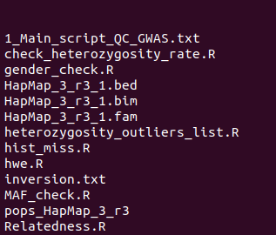
Create a working directory where you plan to conduct the analysis following the tutorial guidelines
mkdir {name of your directory}
Example command: mkdir GWAS
Go into that folder and download files from the GitHub page
git clone https://github.com/MareesAT/GWA_tutorial.git
Executing the command to extract files
cd /home/Sangeetha/GWAS
unzip 1_QC_GWAS.zip
cd 1_QC_GWAS
Extracted zip file contained these files

Slide 10
START ANALYSIS
Quality Control

Slide 11
QC of genetic data
The raw genotype data has several inherent imperfections and require rigorous QC before beginning the analysis
The seven QC steps considered in this tutorial to filter out of the imperfect SNPs and individuals are as follows:
Individual and SNP missingness
Inconsistent assignment of genetic sex of subjects (sex discrepancy)
Minor allele frequency (MAF)
Deviations from Hardy–Weinberg equilibrium (HWE)
Heterozygosity rate
Cryptic relatedness
Population stratification

Slide 12
QC-Step 1
Missingness of SNPs and individuals

Slide 13
Steps followed to check missingness of SNPs and individuals
Go into the folder 1_QC_GWAS and run the command
plink --noweb --bfile HapMap_3_r3_1 --missing
Note:
--noweb is option that tells PLINK that it is not connected to the internet
--bfile indicates the binary files where the genotype data is present
--missing produces a report of missing genotype data per individual and marker
OBSERVATIONS:
1457897 SNPs and 165 individuals taken for the study
53 individuals with missing phenotypes

Slide 14
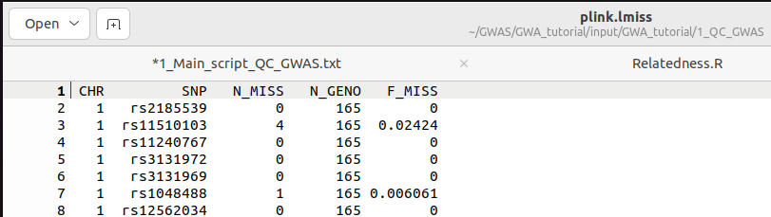
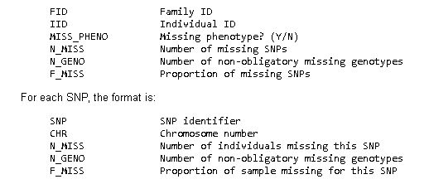
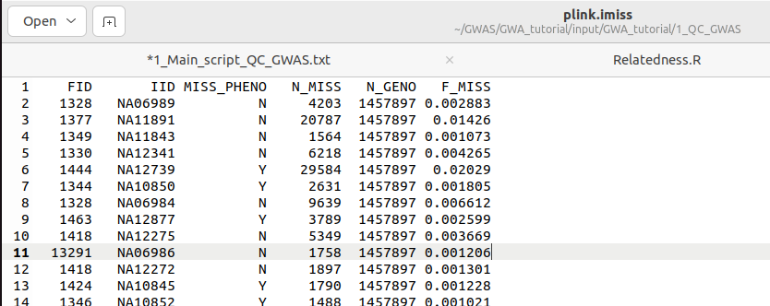
Output screenshots Output was two files: plink.lmiss (for SNPlocus) and plink.imiss (for individual) These look like the screenshots below
…check missingness
Abbreviations

Slide 15
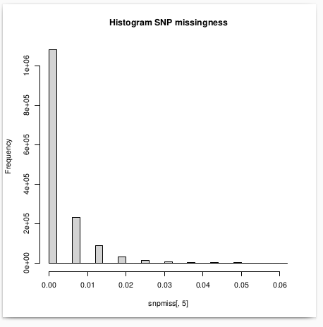
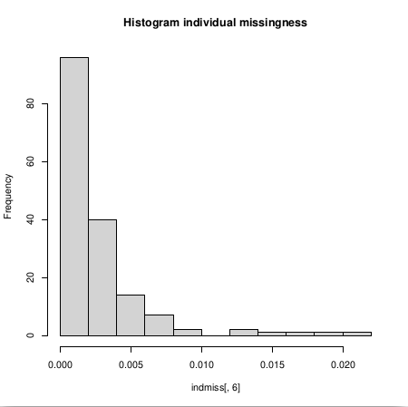
2. Visualization of missingness by producing histograms of missing values of SNPs and Individuals (the --no-save helps not to save the workspace image)
…check missingness
Rscript --no-save hist_miss.R
Output screenshots

Slide 16
Filtering missing SNPs and individuals by non-stringent thresholds (20%) and stringent thresholds (2%) using --geno (exclude SNPs) and --mind (exclude individuals) commands
…check missingness
QC command to delete SNPs with missingness >0.2
plink --noweb --bfile HapMap_3_r3_1 --geno 0.2 --make_bed --out HapMap_3_r3_2
QC command to delete individuals with missingness >0.2
plink --noweb --bfile HapMap_3_r3_2 --mind 0.2 --make_bed --out HapMap_3_r3_3
QC command to delete SNPs with missingness >0.02
plink --noweb --bfile HapMap_3_r3_3 --geno 0.02 --make_bed --out HapMap_3_r3_4
QC command to delete individuals with missingness >0.02
plink --noweb --bfile HapMap_3_r3_4 --mind 0.02 --make_bed --out HapMap_3_r3_5
From step 3 and 4 (non-stringent), no SNPs and individuals were deleted
Step 5: After frequency and genotyping pruning: 1430443 SNPs are remaining
Step 6: 0 individuals were removed for low genotyping

Slide 17
QC-Step 2
Checking Sex discrepancy

Slide 18
Steps followed to check sex discrepancy
Check for sex discrepancy using --check-sex option that reports inconsistencies in sex information of individuals and makes .sexcheck file
plink –noweb --bfile HapMap_3_r3_5 --check-sex
Visualization of sex-check results
Rscript --no-save gender_check.R
Delete individuals with sex discrepancy
Command to enlist individuals with sex discrepancy by flagging as ‘PROBLEM’
grep “PROBLEM” plink.sexcheck| awk ‘{print$1, $2}’ >sex_discrepancy.txt
b) Command to remove the individuals in the above list
plink --noweb --bfile HapMap_3_r3_5 --remove-sex_discrepancy.txt --make-bed --out HapMap_3_r3_6

Slide 19
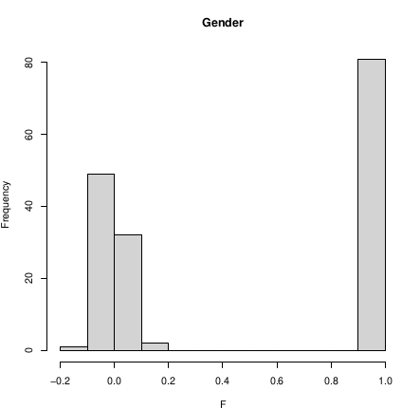
Output screenshot
…sex discrepancy
After filtering, one female removed from the file
Number of males left: 80
Number of females: 84 (earlier 85)
Number of unspecified sex: 0
52 missing (earlier 53)

Slide 20
QC-Step 3
Checking minor allele frequency (MAF)

Slide 21
Selection of autosomal SNPs without low minor allele frequency (MAF)
Command to select only autosomal SNPs
a) awk '{ if ($1 >= 1 && $1 <= 22) print $2 }' HapMap_3_r3_6.bim > snp_1_22.txt
b) plink --noweb --bfile HapMap_3_r3_6 --extract snp_1_22.txt --make-bed --out HapMap_3_r3_7
Visualization of MAF distribution
plink --noweb --bfile HapMap_3_r3_7 --freq --out MAF_check
Rscript --no-save MAF_check.R
Removal of SNPs with low MAF (below 0.05)
plink --no-web --bfile HapMap_3_r3_7 --maf 0.05 --make-bed --out HapMap_3_r3_8

Slide 22
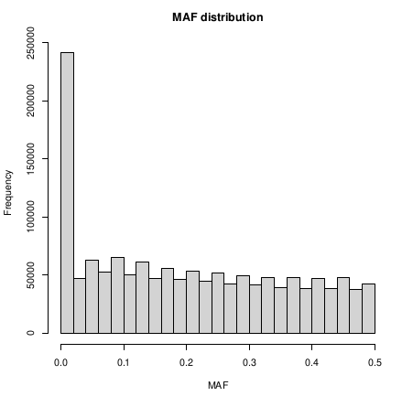
…minor allele frequency
Output screenshot
After frequency and genotyping pruning: 1073226 SNPs

Slide 23
QC-Step 4
Hardy-Weinberg equilibrium (HWE)

Slide 24
Delete SNPs not in HWE
Checking for distribution of Hardy-Weinberg equilibrium (HWE) p-values of SNPs
plink --noweb --bfile HapMap_3_r3_8 --hardy
Selecting SNPs with HWE p-value below 0.00001
awk '{ if ($9 <0.00001) print $0 }' plink.hwe>plinkzoomhwe.hwe
Rscript --no-save hwe.R
Filtering HWE for controls (hwe 1e-6 threshold)
plink --noweb --bfile HapMap_3_r3_8 --hwe 1e-6 --make-bed --out HapMap_hwe_filter_step1
Filtering HWE for cases (hwe 1e-10 threshold)
plink –noweb --bfile HapMap_hwe_filter_step1 --hwe 1e-10 --hwe-all --make-bed --out HapMap_3_r3_9
Zero markers failed HWE test for both cases and controls

Slide 25
QC-Step 5
Heterozygosity rate

Slide 26
Steps to remove heterozygosity rate outliers
Abnormal heterozygosity rate checks are performed on SNPs that are not highly correlated (High LD) by first generating a list of these SNPs
plink --noweb --bfile HapMap_3_r3_9 --exclude inversion.txt --range --indep-pairwise 50 5 0.2 --out indepSNP
Here, the command --exclude inversion.txt will enlist all non -highly correlated SNPs
The command --indep-pairwise will prune the SNPs
The parameters '50 5 0.2' refers to the following:
50: window size, is the number of SNPs in a window
5: number of SNPs to shift the window at each step
0.2: multiple correlation coefficient for a SNP being regressed on all other SNPs simultaneously
The window size and the number of SNPs to shift the window at each step are used to divide the genome into non-overlapping windows
Multiple correlation coefficient is used to determine the strength of the association between a SNP and the other SNPs in the window

Slide 27
…Steps to remove heterozygosity rate outliers
Pruned dataset
plink –noweb --bfile HapMap_3_r3_9 --extract indepSNP.prune.in --het --out R_check
Visualisation of heterozygosity rate distribution
Rscript --no-save check_heterozygosity_rate.R
List of individuals who deviate >3 STD from the heterozygosity rate mean
Rscript --no-save heterozygosity_outliers_list.R
Output of the command above: fail-het-qc.txt
Adapt this file to make it compatible for PLINK, by removing all quotation marks from the file and selecting only the first two columns
sed 's/"// g' fail-het-qc.txt | awk '{print$1, $2}'> het_fail_ind.txt
Remove heterozygosity rate outliers
plink --noweb --bfile HapMap_3_r3_9 --remove het_fail_ind.txt --make-bed --out HapMap_3_r3_10

Slide 28
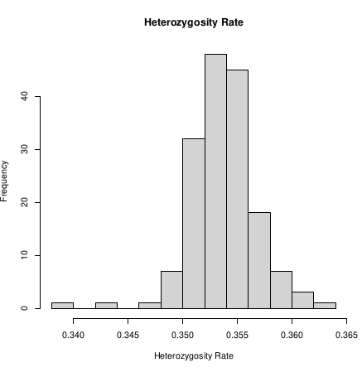
…Steps to remove heterozygosity rate outliers
Output screenshots

Slide 29
QC-Step 6
Cryptic relatedness

Slide 30
Steps to analyse cryptic relatedness
Execute the command to use HapMap_3_r3_10 dataset and extract the variants specified in indepSNP.prune.in. Compute the IBD estimates using --genome’ flag by filtering the estimates above 0.2 and then output the results to files with prefix "pihat_min0.2"
plink --noweb --bfile HapMap_3_r3_10 --extract indepSNP.prune.in --genome --min 0.2 --out pihat_min0.2
2. Create file containing parent-offspring relationship: filtering out lines in pihat_min0.2.genome file where value in 8th field is <=0.9 and writing remaining lines to zoom_pihat.genome file
awk '{ if ($8 >0.9) print $0 }' pihat_min0.2.genome>zoom_pihat.genome
3. Visualize the type of relationship
Rscript --no-save Relatedness.R

Slide 31
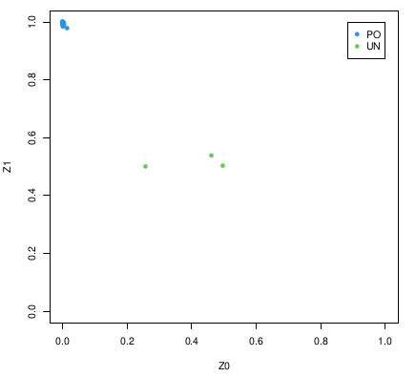
…Cryptic relatedness
Output screenshots
The PO individuals are clustered together on the top left corner of the diagonal line showing a strong positive correlation between the Z0 and Z1, suggesting they are likely parent-offspring pairs

Slide 32
Steps to analyse cryptic relatedness
Command to pick only founders (individuals without parents) so that relatedness due to parent-offspring get excluded
plink --noweb --bfile HapMap_3_r3_10 --filter-founders --make-bed --out HapMap_3_r3_11
Generate file that excludes all non-founders
plink --noweb --bfile HapMap_3_r3_11 --extract indepSNP.prune.in --genome --min 0.2 --out pihat_min0.2_in_founders
Remove individual with the lowest call rate for each pair of related individuals
plink --noweb --bfile HapMap_3_r3_11 –missing
Delete the individuals with the lowest call rate in 'related' pairs with a pihat > 0.2
plink --noweb --bfile HapMap_3_r3_11 --remove 0.2_low_call_rate_pihat.txt --make-bed --out HapMap_3_r3_12

